Slide 1

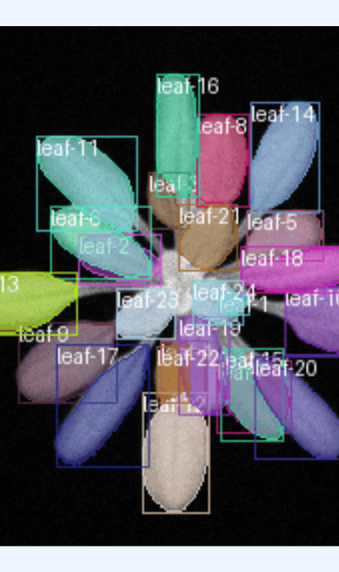
Robustness Evaluation of LeTra (Jurado-Ruiz et al., 2024)Leaf Tracking Under Image Degradations
Sumitra Shrestha
CS Department - SIUE, IL, USA
Advisor: Dr. Rubi Quinones

Slide 2
The Big Problem
High-throughput phenotyping depends on image-based analysis
Most tracking methods assume clean, high-quality images
Real-world data is often degraded (blur, noise, lighting changes)
Research Gap: Robustness of leaf tracking under such conditions is unclear
Our Goal: Evaluate LeTra’s performance under simulated degradations

Slide 3
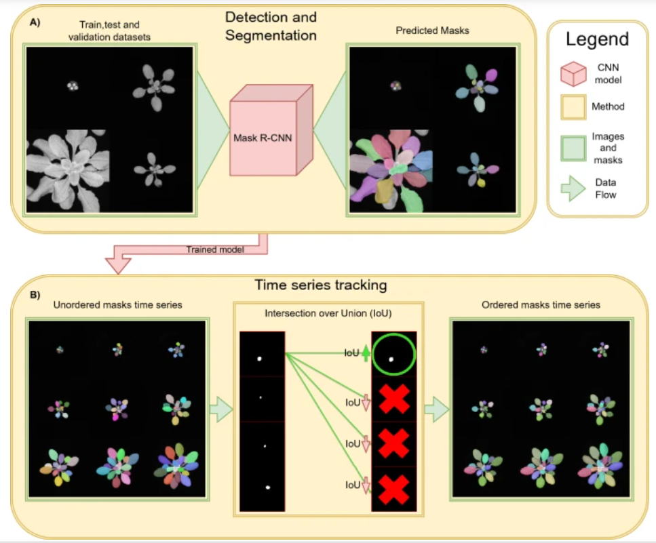
Introduction to LeTra
LeTra: Lightweight leaf tracking pipeline for plant phenotyping
Uses Mask R-CNN for segmentation of individual leaves
Tracks leaf identities over time via IoU-based matching
Designed for chlorophyll fluorescence images of Arabidopsis thaliana
Modular design: easily adaptable for other datasets
Recent and open-sourced

Slide 4
Literature Review
Feature-Based Methods:
Chamfer Matching (Yin et al., 2014, 2018) struggles under occlusion and growth variation
Traditional methods (e.g., Hough Transform, watershed) fail under noise or lighting variation
Learning-Based Methods:
LeTra (Jurado-Ruiz et al., 2024): Mask R-CNN + IoU tracking
LeafMask, Eff-UNet++: high accuracy but limited degradation testing
Synthetic training data improves generalization, not robustness
Gap Identified:
Most studies benchmark on ideal, clean images
Few evaluate models under real-world degradations (blur, noise, lighting)
Our study fills this gap by testing LeTra under 3 degradation types

Slide 5
Literature Review Comparative Summary of Existing Leaf Datasets
Dataset | Species / Type | Modality | Size / Resolution
Tomato Leaf Dataset | Tomato / Real | RGB | 1,408 images, 160×200 to 3888×2592
CVPPP A1–A5 | Arabidopsis, Tobacco / Real | RGB | ~1,300 images, up to 3108×2324
Synthetic Leaf | Arabidopsis / Synthetic | RGB | 30,000 synthetic images
KOMATSUNA | Komatsuna / Real | RGB, RGB-D | 900 images, 480×480
MSU-PID | Arabidopsis, Bean / Real | RGB, IR, Depth | 576 images, ~116×119
Eff-UNet++ (CVPPP) | Arabidopsis, Tobacco / Real | RGB | 810 images, 512×512
LeTra | Arabidopsis / Real | Chlorophyll Fluorescence (CF) | 149 train, 53 val, 204 tracked leaves
UNL-CPPD | Maize / Real | RGB, IR, NIR, Fluor, Hyperspectral | ~702 images, 2 views × 27 days

Slide 6
Research Objectives
Quantitatively assess LeTra's robustness under 3 degradation types:
Gaussian Blur (3x3, 5x5, 7x7)
Salt and Pepper Noise (0.01, 0.025, 0.04)
Brightness/Contrast adjustments (0.7/0.8, 0.9/1.1, 1.3/1.2)
Compare performance using F1-score, IoU and IDF1 scores against clean dataset.
Note: High IDF1 indicates that the tracker is not only detecting objects correctly but also maintaining their identities consistently over time.

Slide 7
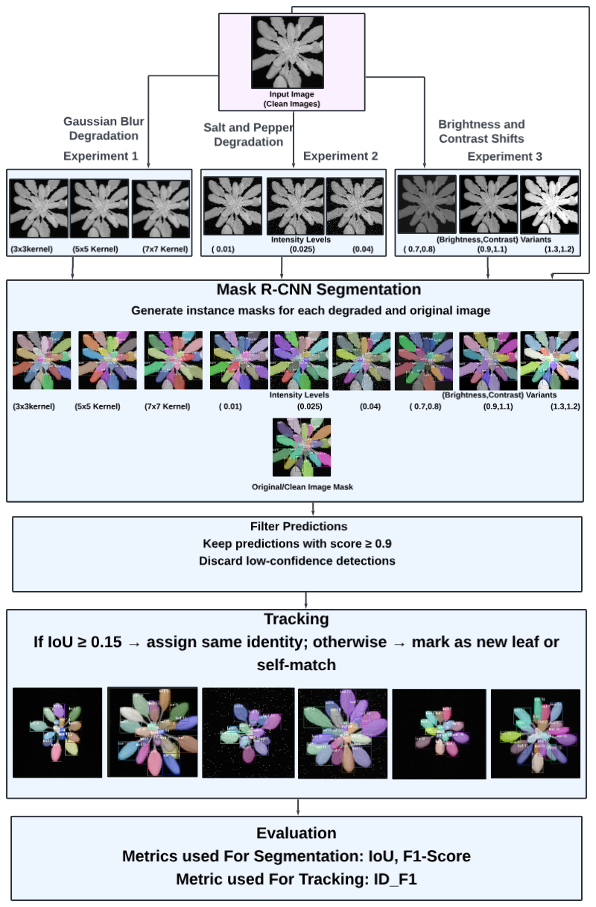
Methodology
Step 1: Use pretrained LeTra Mask R-CNN for segmentation
Step 2: Apply degradations to original Arabidopsis images
Step 3: Predict degraded masks
Step 4: Track leaf identities over time using IoU-based matching
Step 5: Evaluate detection, segmentation, tracking performance

Slide 8
Experimental Design
Goal: Test LeTra’s robustness under simulated image degradations
Dataset: Arabidopsis tray images (same as original LeTra)
Total Evaluated:
Segmentation: 523 leaves (Early, Mid, Late)
Tracking: 204 leaves across 9 plants, 57 timepoints
Experiments:
Gaussian Blur Comparison: 3×3, 5×5, 7×7
Salt & Pepper Noise Comparison: 0.01, 0.025, 0.04
Brightness/Contrast Comparison: (0.7/0.8), (0.9/1.1), (1.3/1.2)

Slide 9
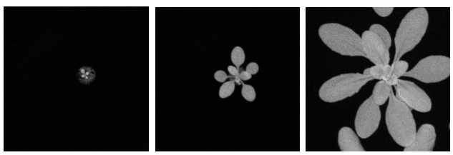
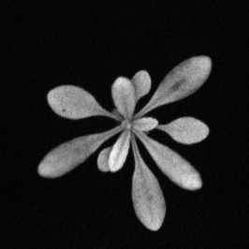
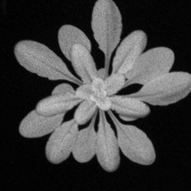
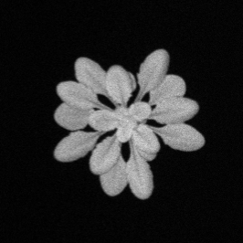
Experimental Design
Datasets Used Segmentation Dataset
-53 grayscale images(266×266 pixels) from 18 Arabidopsis thaliana plants.
Divided into Early Stage: 17 images (1 removed due to no visible leaves), Mid Stage: 18 images,Late Stage: 18 images
523 leaves used, ensuring the model's ability to generalize across developmental stages.
Tracking Evaluation Dataset:
Separate dataset of 9 plants(266×266 pixels) tracked over 57 timepoints.
Total: 204 leaves.
Purpose: Exclusively used for tracking evaluation — not for training or validation of the Mask R-CNN model.

Slide 10
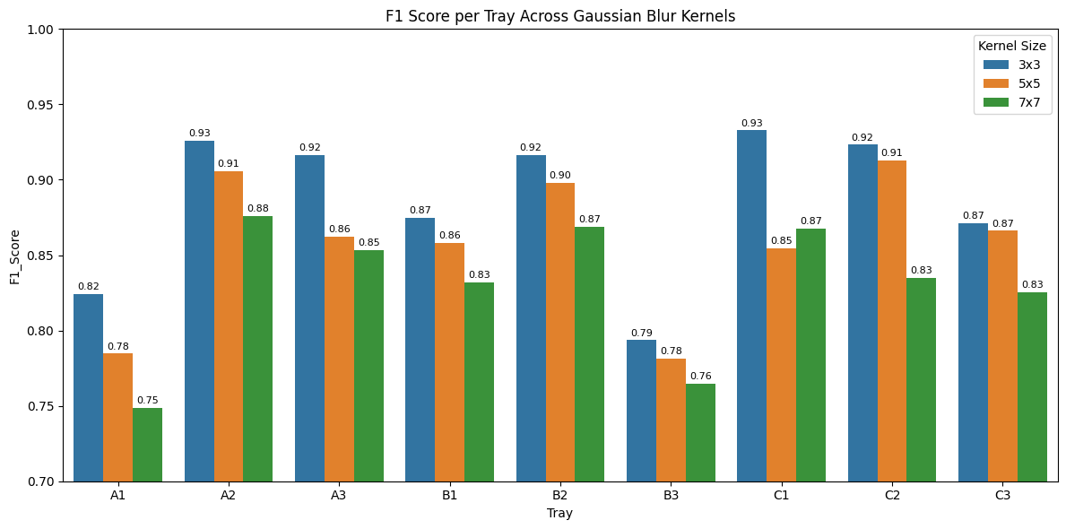
Results – Gaussian Blur
F1 score drops as blur increases (3×3 > 5×5 > 7×7).
3×3 kernel shows best performance (peak: 0.93).
Strong trays: A2, B2, C2 (high scores across all kernels).
Weak trays: A1, B3 (most affected by blur).
Larger kernels reduce segmentation accuracy.
LeTra model is sensitive to heavy blur – robust under mild blur only.

Slide 11
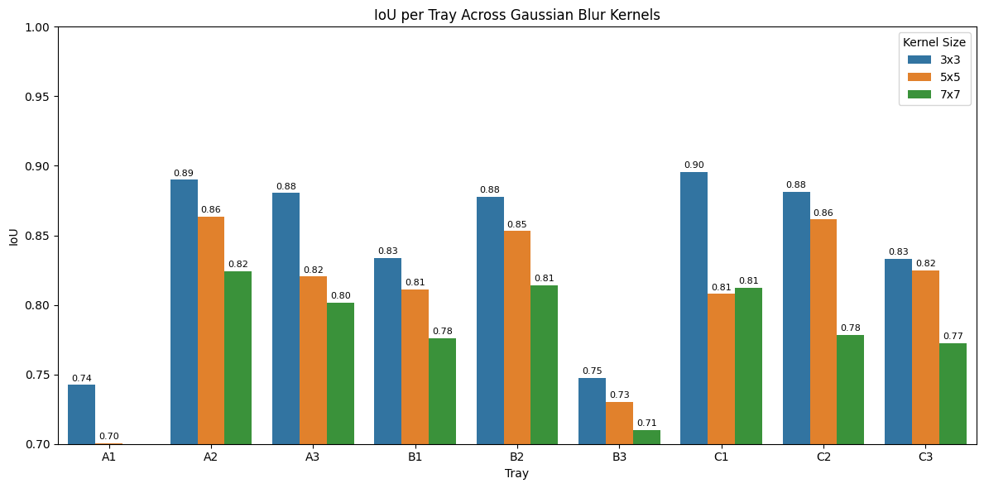
Results – Gaussian Blur
Higher IoU with smaller blur: 3×3 kernel consistently yields highest IoU across trays.
Strongest performance: C1 (0.90), A2 (0.89), B2 (0.88) with 3×3 blur.
IoU drops with kernel size: 7×7 blur causes visible reduction across all trays.
Most blur-sensitive trays: A1 and B3 show the lowest IoU under all conditions.
3×3 remains most robust, while 7×7 impacts segmentation accuracy significantly.
Conclusion: IoU metric confirms the LeTra model’s performance degrades with heavier blurring—especially for trays with denser or more complex leaf arrangements.

Slide 12
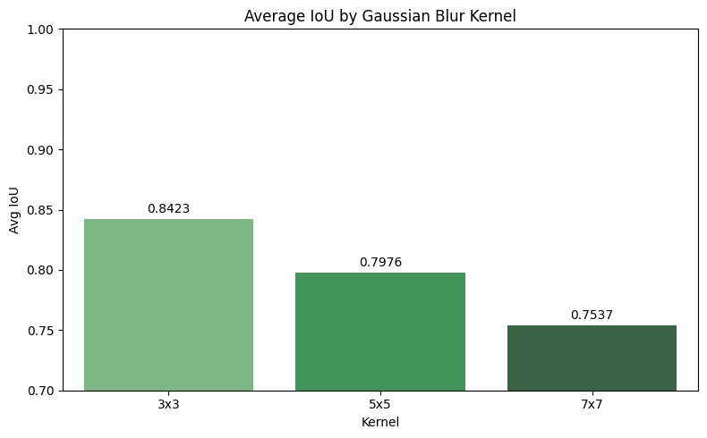
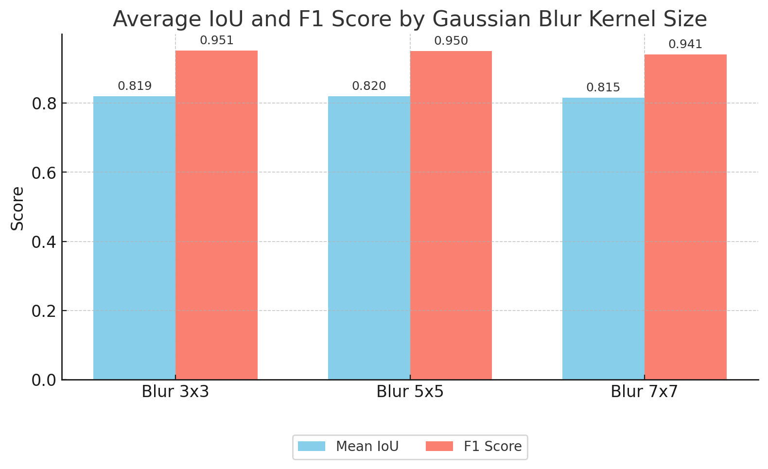
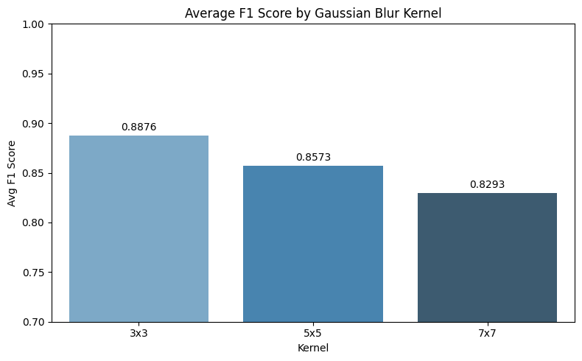
Results – Gaussian Blur

Slide 13
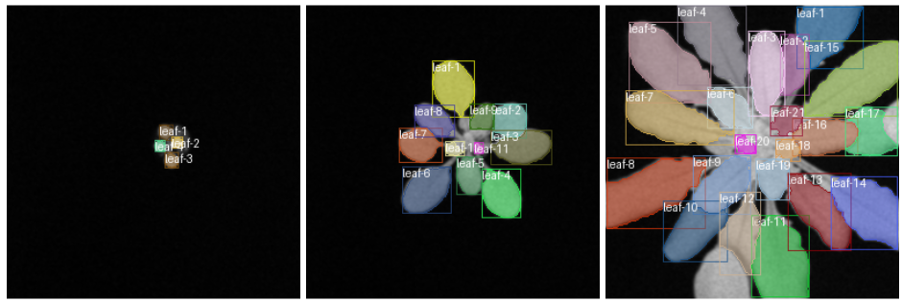
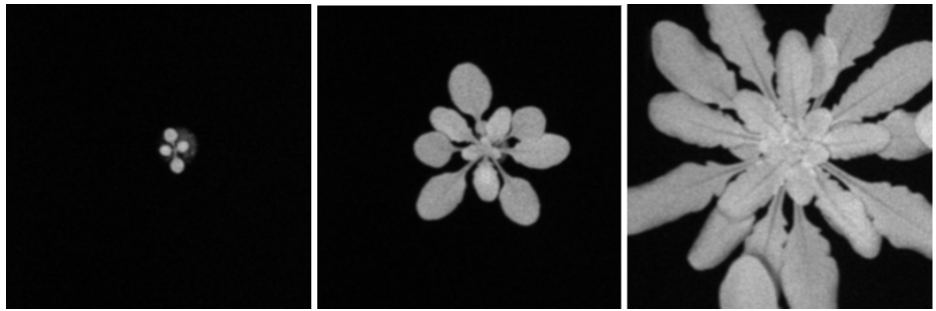
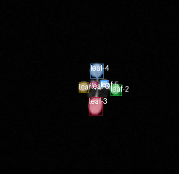
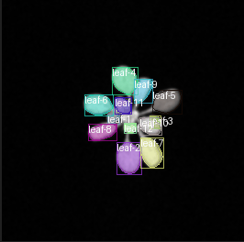
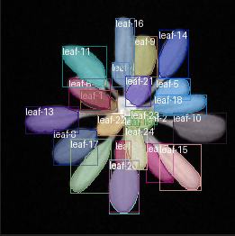
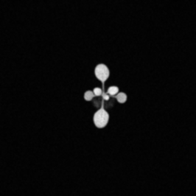
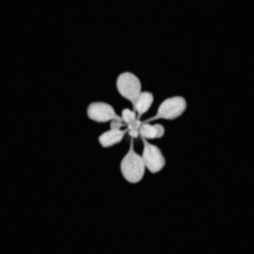
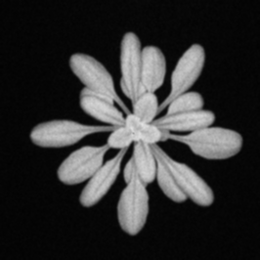
Results – Gaussian Blur Segmentation dataset T Tracking dataset

Slide 14
Results – Gaussian Blur
The predictions on blurred images using a 3×3 Gaussian kernel.
Top row: Segmentation dataset—leaf boundaries remain well defined even under blur.
Bottom row: Tracking dataset—leaf identity is consistently maintained across timepoints.
Model shows strong robustness to mild blur across both datasets.
Visual results support high F1 and IoU scores seen in earlier plots.

Slide 15
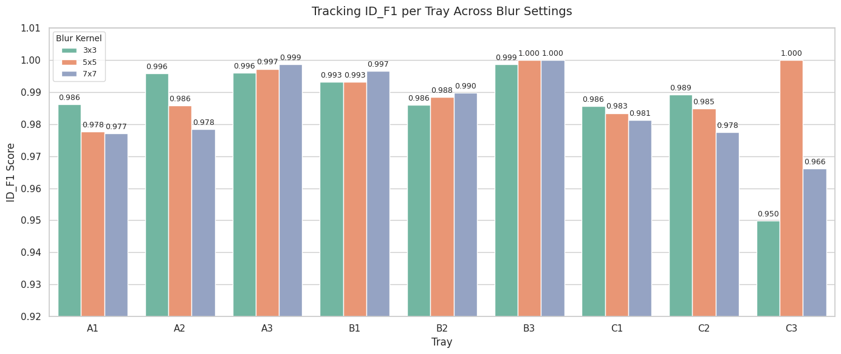
Results –Gaussian Blur
ID F1 Scores are consistently very high, even with blur.
Most trays score above 0.98, showing strong tracking stability.
B3 and C3 reach perfect 1.000 under 5×5 and 7×7 blur.
Minor drops occur (e.g., C2, C3) but still stay above 0.95.
Conclusion: LeTra’s tracking is highly robust to blur, even when segmentation slightly degrades.

Slide 16
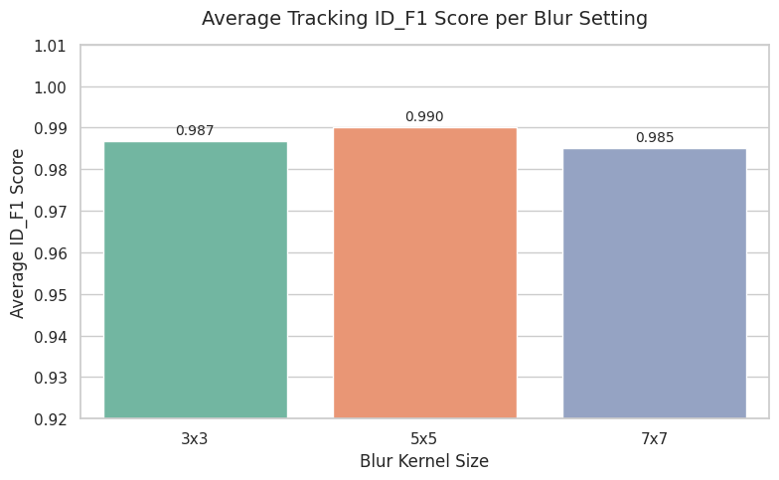
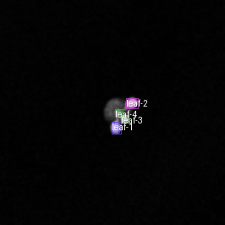
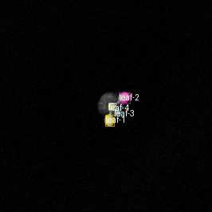
Results –Gaussian Blur
Degraded​
Original​​

Slide 17
Results –Gaussian Blur
Best performance observed at 5×5 blur with an average ID_F1 score of 0.990.
Slight drop with 3×3 (0.987) and 7×7 (0.985), showing minimal sensitivity to blur severity.
5×5 Gaussian blur balances noise reduction and detail preservation—removing small noise without overly blurring leaf edges, which helps maintain tracking accuracy.
Visual Comparison:
The Degraded image (left) under blur still accurately preserves leaf identities and bounding boxes.
Original image (right)

Slide 18
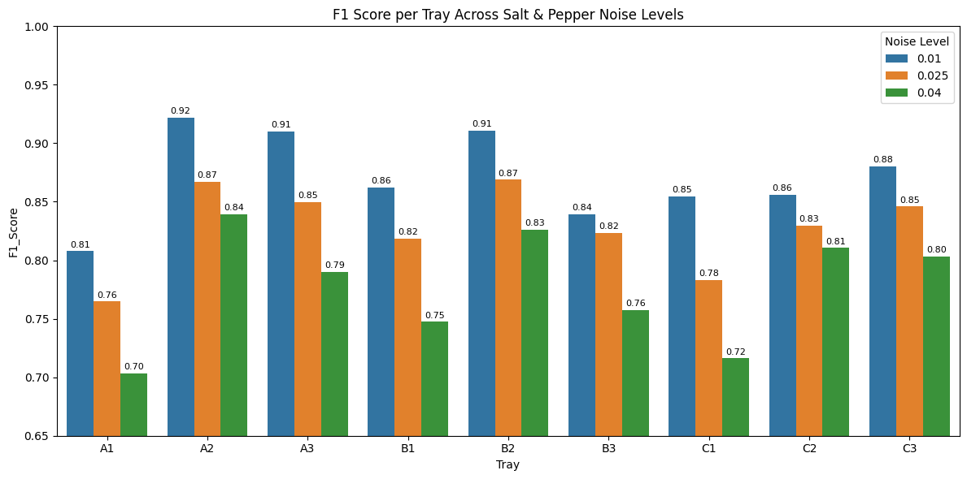
Results – Salt&Pepper
F1 score drops as noise increases (0.01 → 0.04).
Best performance at 0.01 noise level (e.g., A2, B2, C3 above 0.90).
Worst impact seen at 0.04 noise (A1, B1, C1 around 0.70–0.72).
A2 and B2 stay relatively strong across all levels.
LeTra model is sensitive to high salt & pepper noise.

Slide 19
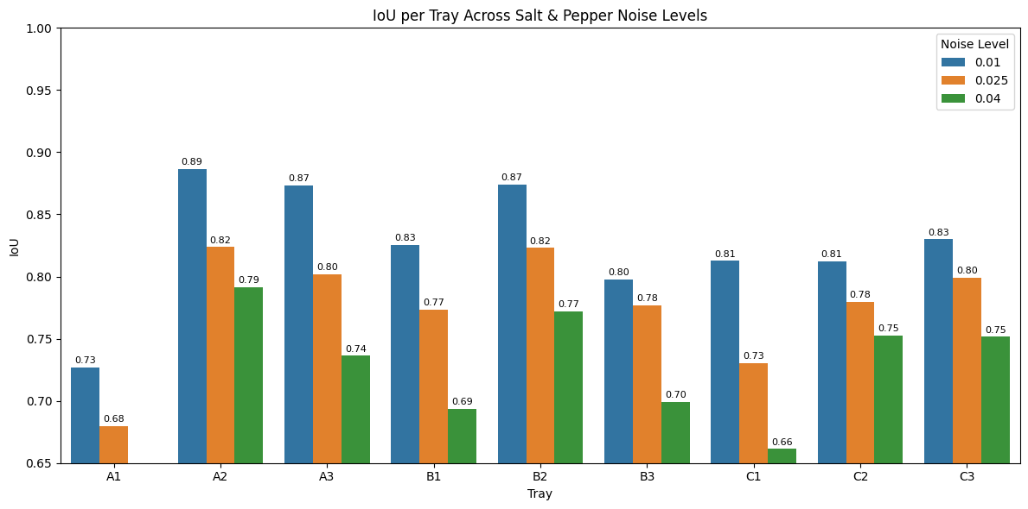
Results – Salt&Pepper
IoU scores decrease steadily with increasing noise (0.01 → 0.04).
Best scores at 0.01 noise: A2, A3, B2 score around 0.87–0.89.
Heavy noise (0.04) causes sharp drops, especially in C1 (0.66) and B1 (0.69).
A2 and B2 remain more stable, showing better noise resilience.
Conclusion: Salt & pepper noise has a strong negative impact on segmentation quality, especially at high noise levels.

Slide 20
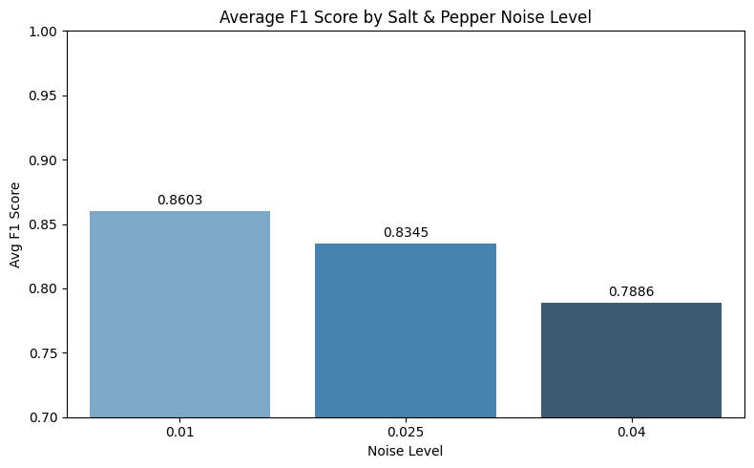
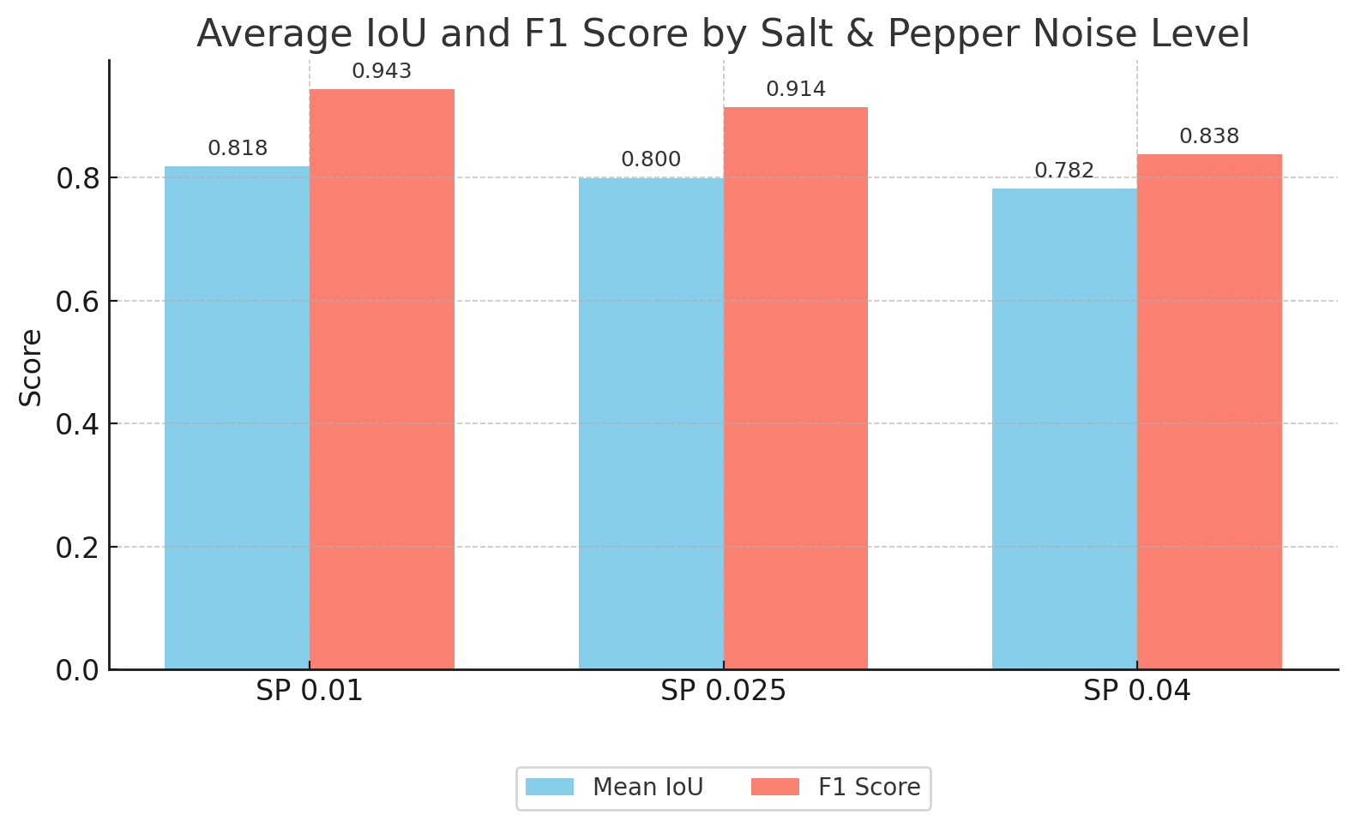
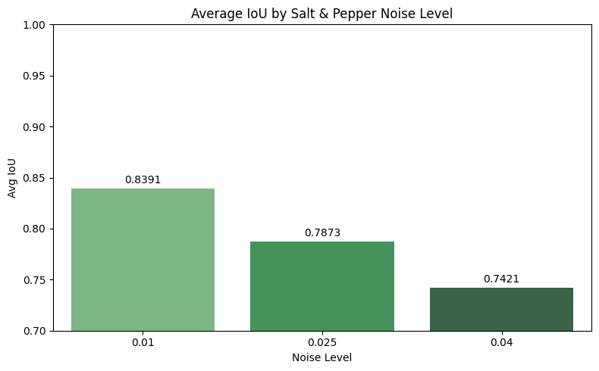
Results – Salt&Pepper

Slide 21
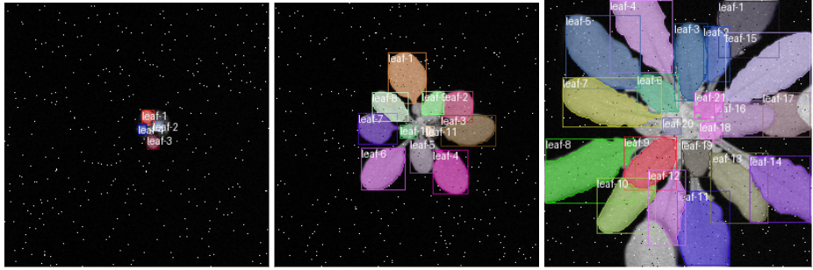
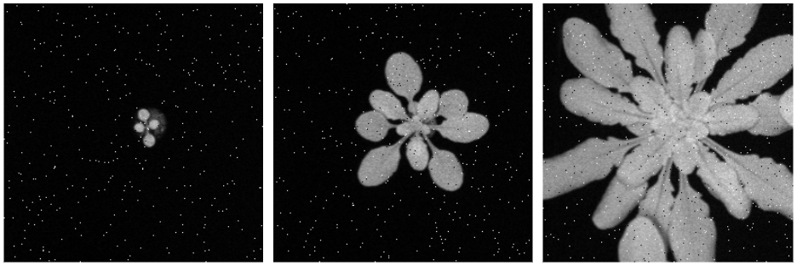
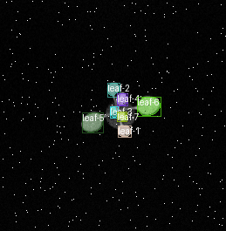
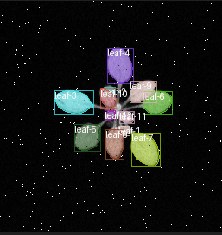
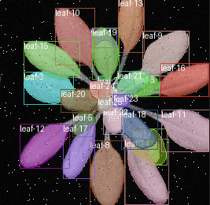
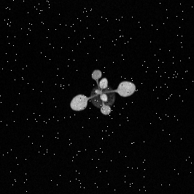
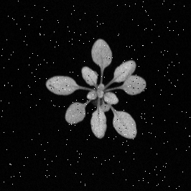
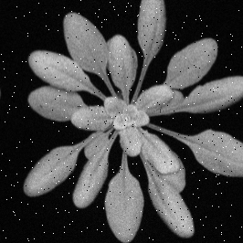
Results – Salt&Pepper
​ ​ ​ ​ ​ Segmentation dataset​
Tracking dataset​

Slide 22
Results – Salt&Pepper
Results shows predictions under 0.01 salt & pepper noise level.
Top row (Segmentation dataset): Despite visible speckle noise, leaf regions are well segmented.
Bottom row (Tracking dataset): Leaf identities are preserved across frames.
Model demonstrates resilience to low-level noise, maintaining reliable output.
Visuals align with strong F1 and IoU scores seen for this setting earlier.

Slide 23
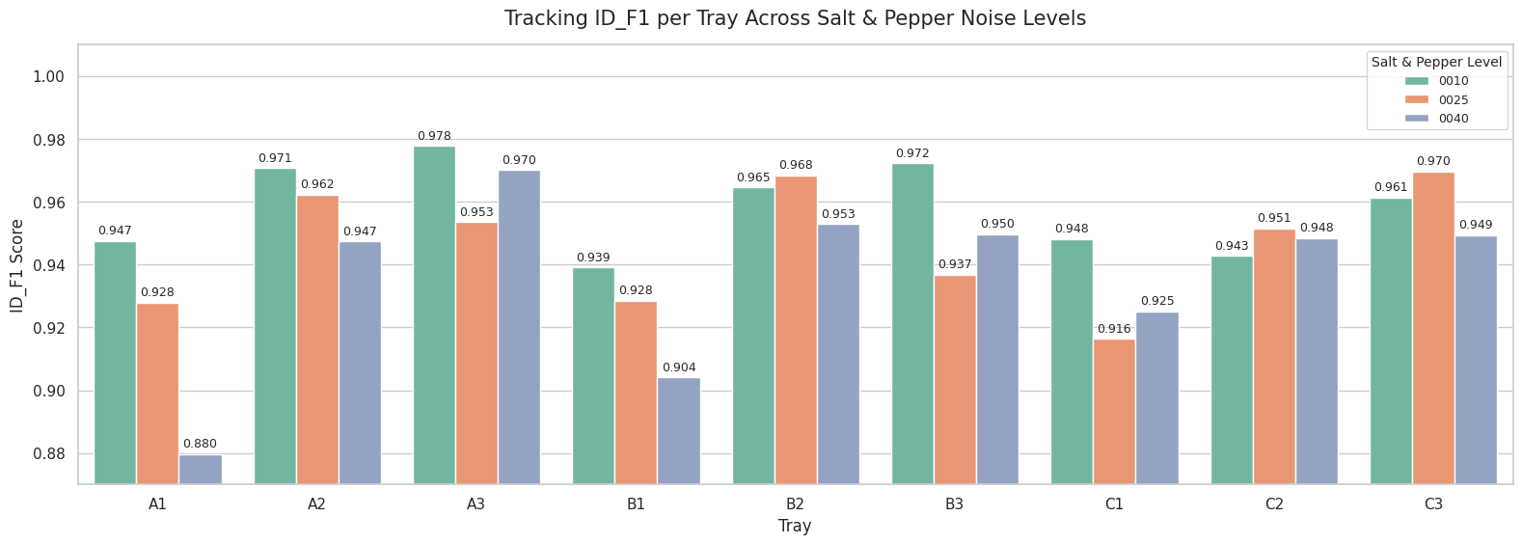
Results – Salt&Pepper
ID F1 scores remain very high (mostly above 0.94), even as noise increases.
Best scores observed in trays A2, A3, B2, C3 — maintaining above 0.96 across all noise levels.
Most affected tray: A1 drops to 0.880 at the highest noise level (0.04).
Despite minor drops, tracking remains robust under salt & pepper noise.
Conclusion: LeTra’s identity tracking stays accurate across noise variations — more stable than segmentation performance.

Slide 24
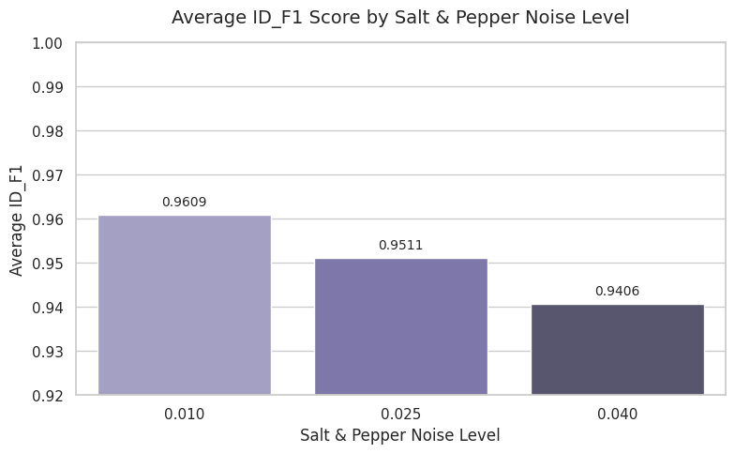
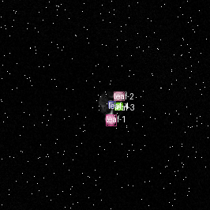
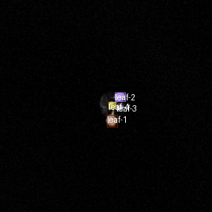
Results – Salt&Pepper
Degraded​
Original​

Slide 25
Results – Salt&Pepper
As salt & pepper noise increases, tracking performance degrades consistently, with ID_F1 dropping from 0.9609 at noise level 0.01 to 0.9406 at 0.04.
Lower noise (0.01) still allows reliable leaf identity tracking, but higher levels introduce visual artifacts that disrupt mask quality and detection.
The left image shows tracking under Salt & Pepper noise (0.01); the right image shows the original clean image result.
Despite visible noise, the model maintains high tracking accuracy (ID_F1 = 0.9609), showing strong robustness at low noise levels.
However, even mild pixel-level corruption slightly reduces segmentation quality compared to the clean condition.

Slide 26
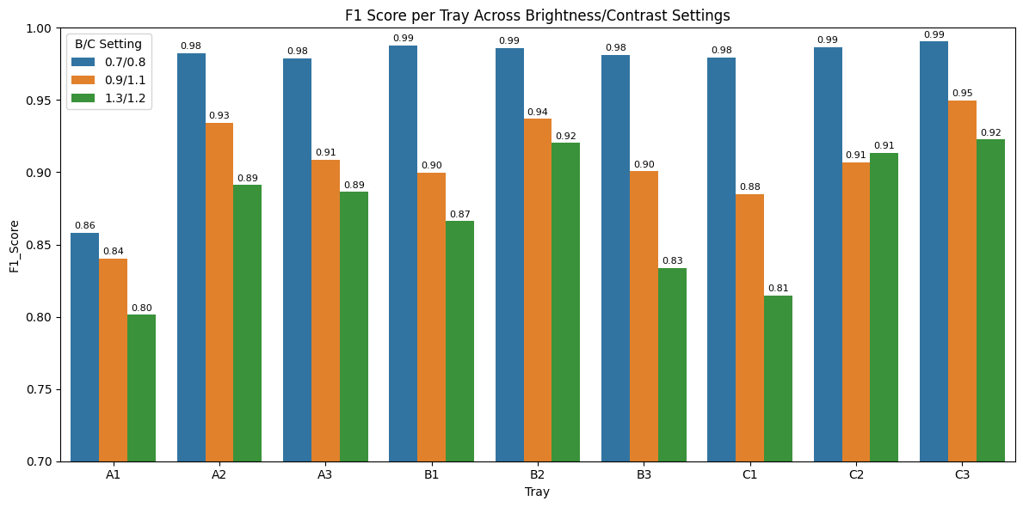
Results – Brightness and Contrast
Best F1 scores achieved with B/C setting 0.7 / 0.8 (blue bars).
Most trays reach above 0.98, some hitting 0.99 (B1, B2, C2, C3).
Performance drops as brightness/contrast increases to 1.3 / 1.2 (green bars).
Trays A1 and C1 are most sensitive, falling to 0.80–0.81 at higher B/C.
Conclusion: Model performs best under slightly darkened conditions and declines with brighter/higher contrast settings.

Slide 27
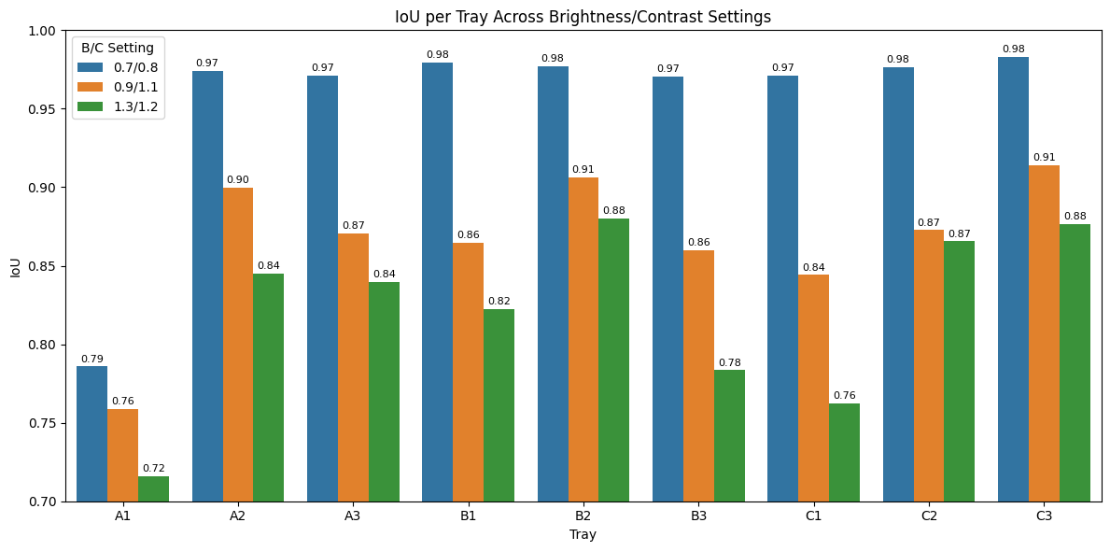
Results – Brightness and Contrast
Best IoU results come from low brightness/contrast (0.7 / 0.8) settings.
Trays A2, A3, B2, C2, C3 achieve IoU ~0.97–0.98 under this setting.
IoU scores decline as brightness/contrast increases to 1.3 / 1.2.
Most affected trays include A1 and C1, dropping to 0.72–0.76 at high B/C.
Conclusion: LeTra segmentation performs best under slightly dimmed conditions, and suffers under brighter, high-contrast lighting.

Slide 28
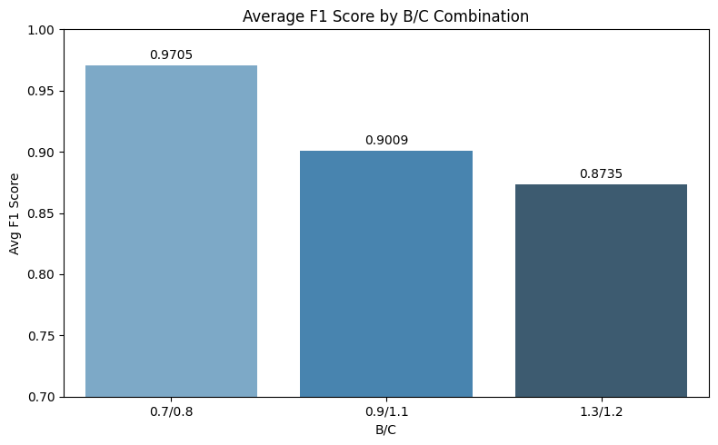

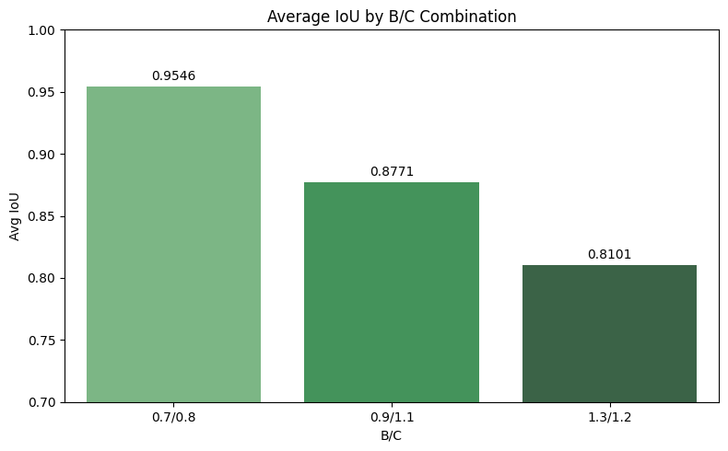
Results – Brightness and Contrast

Slide 29
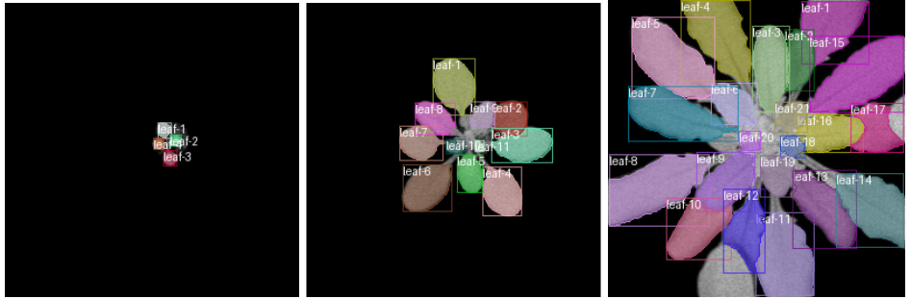
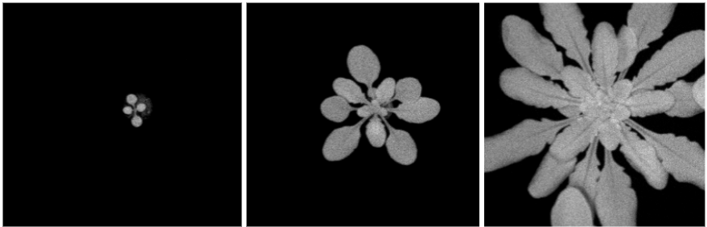
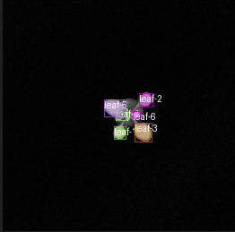
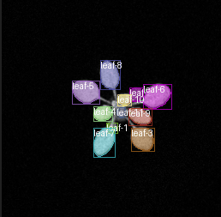
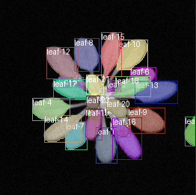



Results – Brightness and Contrast
​​ ​​ ​​ ​​ ​​ Segmentation dataset​​ ​​
Tracking dataset​​

Slide 30
Results – Brightness and Contrast
Top (Segmentation dataset) under B/C = 0.9/1.1:
Segmentation masks remain sharp and well-defined despite brightness/contrast shifts.
Leaf boundaries and labels are clearly preserved.
Bottom (Tracking dataset) under B/C = 0.7/0.8:
Tracking maintains identity over time, though images appear dimmer.
Despite reduced brightness, contour tracking remains reliable.

Slide 31

Results – Brightness and Contrast
Tracking performance remains exceptionally high across all brightness/contrast (B/C) settings.
Most trays show ID F1 scores above 0.97, even at higher B/C variations.
Top trays like A3, B2, B3, and C3 reach near-perfect scores (0.999–1.000).
Slight performance dips at extreme settings — e.g., C1 drops to 0.934.
Conclusion: Identity tracking is highly robust to brightness/contrast changes, far more stable than segmentation scores.

Slide 32



Tracking Results – Brightness and Contrast
Degraded
Original

Slide 33
Tracking Results – Brightness and Contrast
The right image represents the clean tracking result (ideal condition, ID_F1 = 1.0), serving as the performance baseline.
The left image shows tracking under brightness/contrast setting 0.7/0.8, with an ID_F1 score of 0.995, indicating minimal performance drop from the clean result.
This shows that mild B/C degradation (darker/lower contrast) has negligible effect on identity tracking accuracy.
Other B/C settings (0.9/1.1 and 1.3/1.2) caused larger drops, highlighting that subtle adjustments (like 0.7/0.8) are better tolerated by the model.

Slide 34


Clean Vs Best of All Degradation Setting: Segmentation Result

Slide 35
Conclusion: Segmentation
F1 scores remain stable across all growth stages (Early, Mid, Late) even under brightness/contrast changes (0.9/1.1).
IoU scores also show minimal change between clean and adjusted B/C conditions.
Slight increase in IoU at Early stage under adjusted B/C (0.731 vs. 0.725).
Conclusion: Segmentation performance is robust to moderate B/C variation, with only minor differences observed.

Slide 36


Clean Vs Best Degradation Settings: Tracking Result

Slide 37
Conclusion:Tracking
Brightness/Contrast (0.7/0.8) achieved the highest ID_F1 (0.992) – almost as good as clean data.
Gaussian Blur (5×5) and Salt & Pepper (0.01) performed slightly worse, with ID_F1 scores of 0.963 and 0.961 respectively.
The smallest deviation from perfect tracking (ID_F1 = 1.0) is seen with brightness/contrast (only 0.008), confirming its robustness.
Salt & Pepper and Gaussian Blur lead to greater accuracy drops (~0.037–0.039), suggesting higher tracking sensitivity under those degradations.

Slide 38
Findings
Mild degradations (blur, noise, brightness/contrast) have limited effect on segmentation and tracking
Performance degrades progressively with increasing severity of degradation
Tracking ID accuracy remains robust, even when segmentation scores slightly drop
Brightness/Contrast changes were the most degradation-tolerant across all metrics

Slide 39

Future Work
Combining multiple degradations
Testing on other plant species (succulents, maize)
Integrating time-series modeling for long-term growth prediction

Slide 40
Reference
F. Jurado-Ruiz, T.-P. Nguyen, J. Peller, M. J. Aranzana, G. Polder, and M. G. M. Aarts, “LeTra: a leaf tracking workflow based on convolutional neural networks and intersection over union,” Plant Methods, vol. 20, no. 1, p. 11, Jan. 2024, doi: 10.1186/s13007-024-01138-x.
X. Yin, X. Liu, J. Chen, and D. M. Kramer, “Multi-leaf tracking from fluorescence plant videos,” in 2014 IEEE International Conference on Image Processing (ICIP), IEEE, 2014, pp. 408–412. Accessed: Apr. 14, 2025. [Online]. Available: https://ieeexplore.ieee.org/abstract/document/7025081/
X. Yin, X. Liu, J. Chen, and D. M. Kramer, “Joint multi-leaf segmentation, alignment, and tracking for fluorescence plant videos,” IEEE Trans. Pattern Anal. Mach. Intell., vol. 40, no. 6, pp. 1411–1423, 2017.
H. Scharr et al., “Leaf segmentation in plant phenotyping: a collation study,” Mach. Vis. Appl., vol. 27, no. 4, pp. 585–606, May 2016, doi: 10.1007/s00138-015-0737-3.
J. P. Kumar and S. Domnic, “Image based leaf segmentation and counting in rosette plants,” Inf. Process. Agric., vol. 6, no. 2, pp. 233–246, 2019.
R. Guo, L. Qu, D. Niu, Z. Li, and J. Yue, “Leafmask: Towards greater accuracy on leaf segmentation,” in Proceedings of the IEEE/CVF International Conference on Computer Vision, 2021, pp. 1249–1258. Accessed: Apr. 14, 2025. [Online]. Available: https://openaccess.thecvf.com/content/ICCV2021W/CVPPA/html/Guo_LeafMask_Towards_Greater_Accuracy_on_Leaf_Segmentation_ICCVW_2021_paper.html
S. Bhagat, M. Kokare, V. Haswani, P. Hambarde, and R. Kamble, “Eff-UNet++: A novel architecture for plant leaf segmentation and counting,” Ecol. Inform., vol. 68, p. 101583, 2022.
D. Ward, P. Moghadam, and N. Hudson, “Deep Leaf Segmentation Using Synthetic Data,” Mar. 21, 2019, arXiv: arXiv:1807.10931. doi: 10.48550/arXiv.1807.10931.

Slide 41
Thank you!

